Slide 1
















CS360 Project:
Gold Price Prediction
Suraj Yadav
CS32-2201210

Slide 2

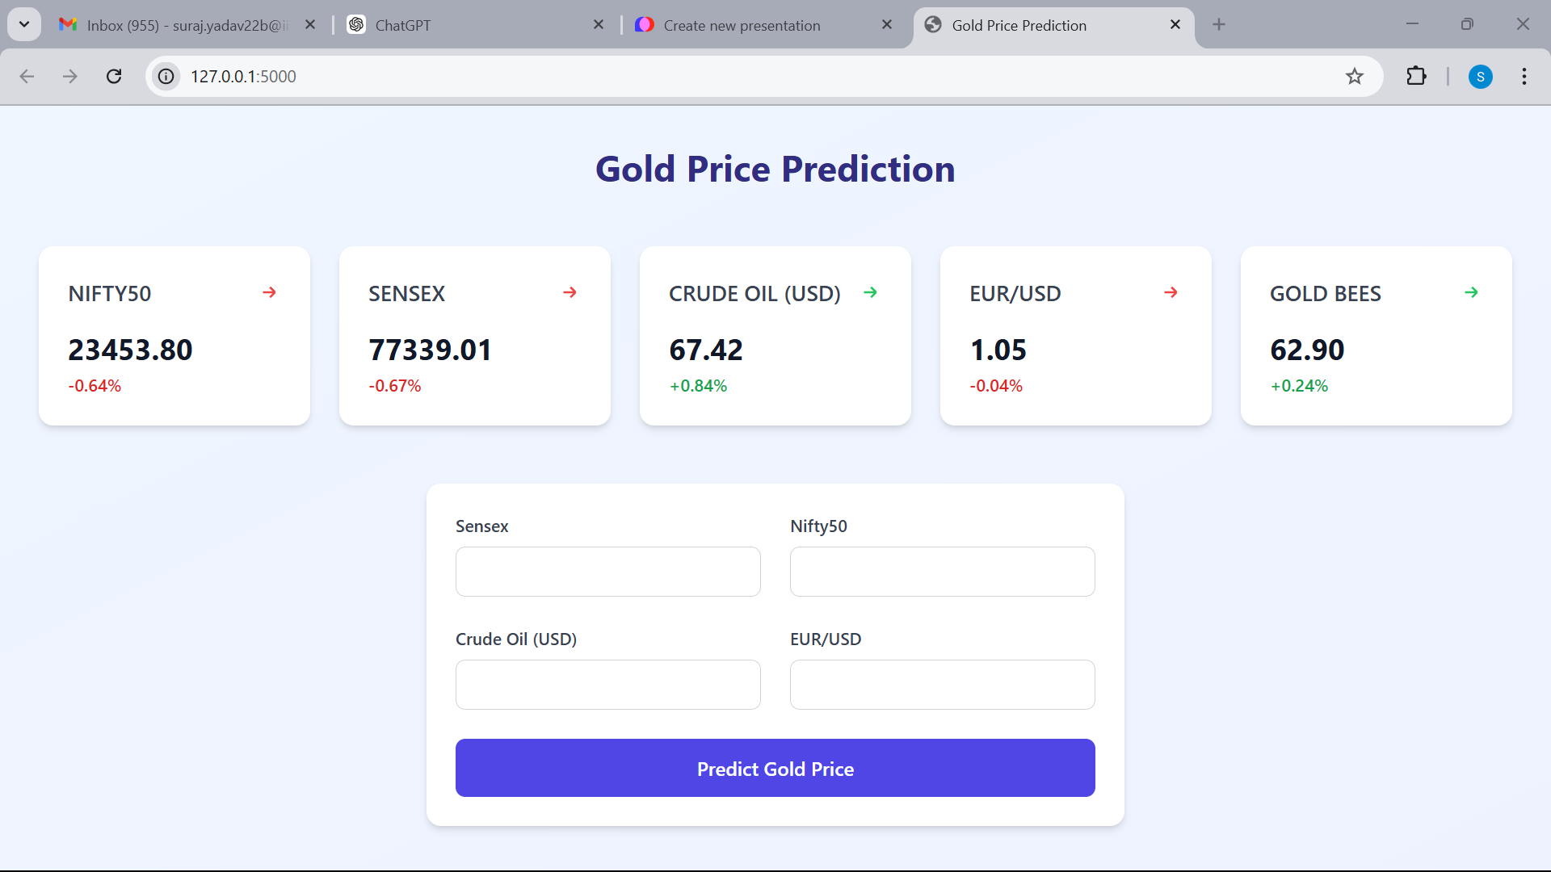





Slide 3
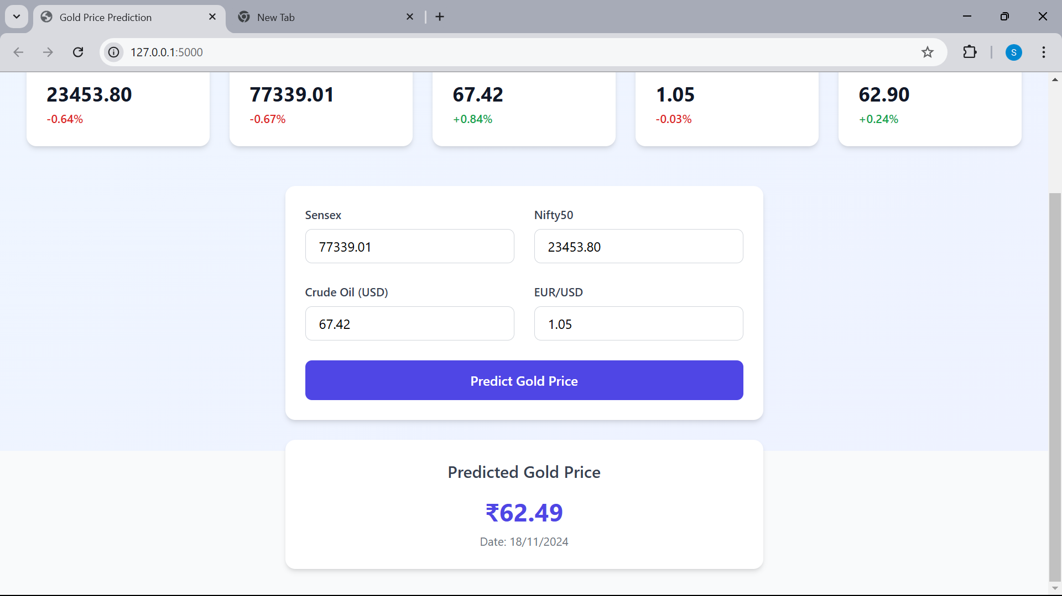

Slide 4


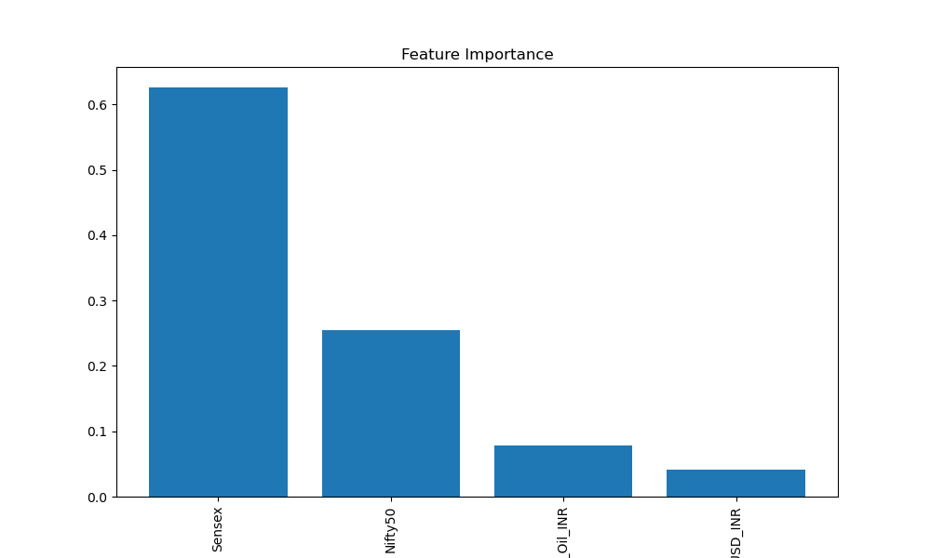


Feature selection:
Nifty 50: Provides a benchmark for the Indian stock market's performance
Sensex: oldest
Crude Oil: critical global commodity
EUR/USD: Interest Rates
GOLD BEES: Want to Predict

Slide 5
DATA SET:
Data January 1, 2009, to November 14, 2004.
Data was retrieved using the Yahoo Finance Python library for each feature
An inner join was applied on the date field to combine the data for comprehensive analysis.

Slide 6
Data Cleaning:
Crude oil and EUR/USD are global indicators, their values were converted into INR to enhance prediction accuracy.
Crude oil and EUR/USD prices change daily, whereas Nifty 50 and Sensex are traded only on weekdays, with closures on weekends and public holidays.
The data was automatically cleaned by applying an inner join to ensure consistency and alignment across all time-series data

Slide 7
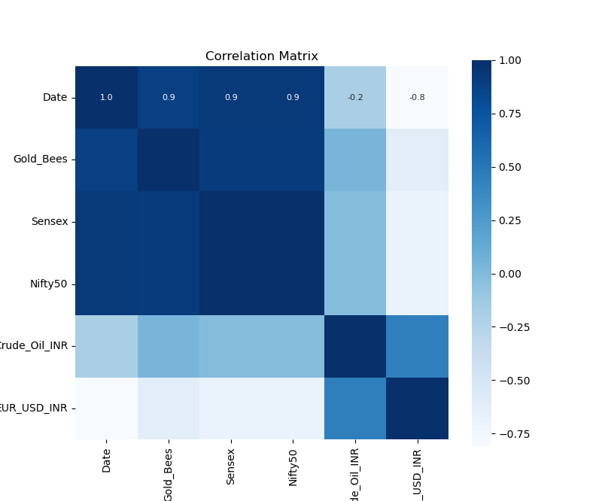
Data Visualization:
Used Seaborn Library to see HeatMap
A heatmap was utilized to analyze the correlation between each feature and its influence on determining gold prices.

Slide 8
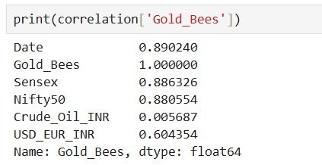
Data Visualization:

Slide 9


Trainning:
A Random Forest Regressor model was employed to train the model, suitable for predicting continuous numerical values.
The dataset was split into an 80:20 ratio for training and testing, respectively.

Slide 10
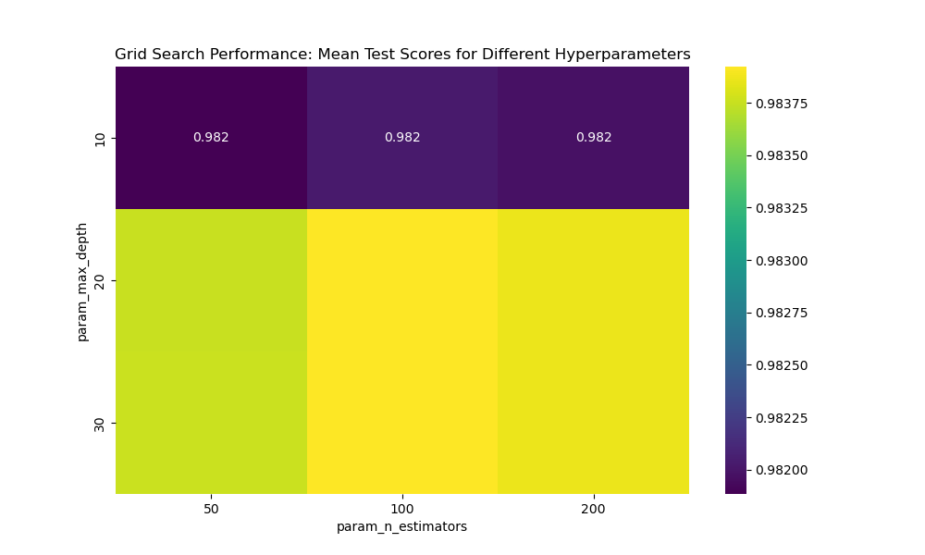
Overfitting
Overfitting was mitigated through hyperparameter tuning using Grid Search, ensuring optimal model performance and generalization.

Slide 11
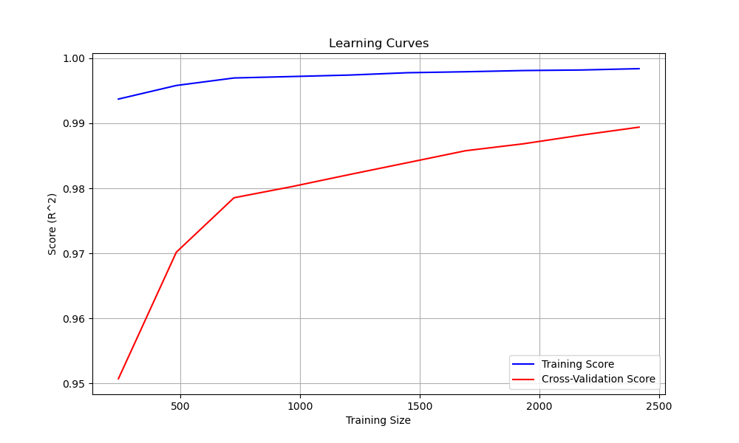
PERFORMANCE:
The model's R² score is provided in the training output, reflecting its accuracy in explaining the variance in the target variable.
Feature importance analysis was conducted to evaluate the contribution of each feature in predicting the target variable.

Slide 12
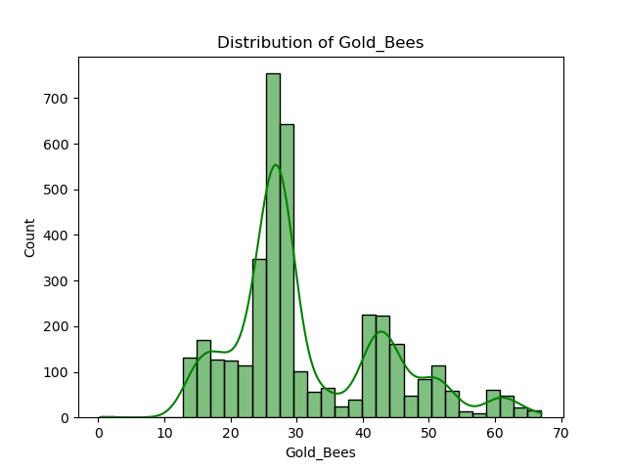
Conclusion

Slide 13
Thank you very much
Dr Moumita Roy
Yeasmin Begum Laskar
Sujoy Paul
Amit Das

